Slide 1

Process Improvement Project
Exercise Improvement
Kelsey Johnson
MBC 638
Winter 2020

Slide 2
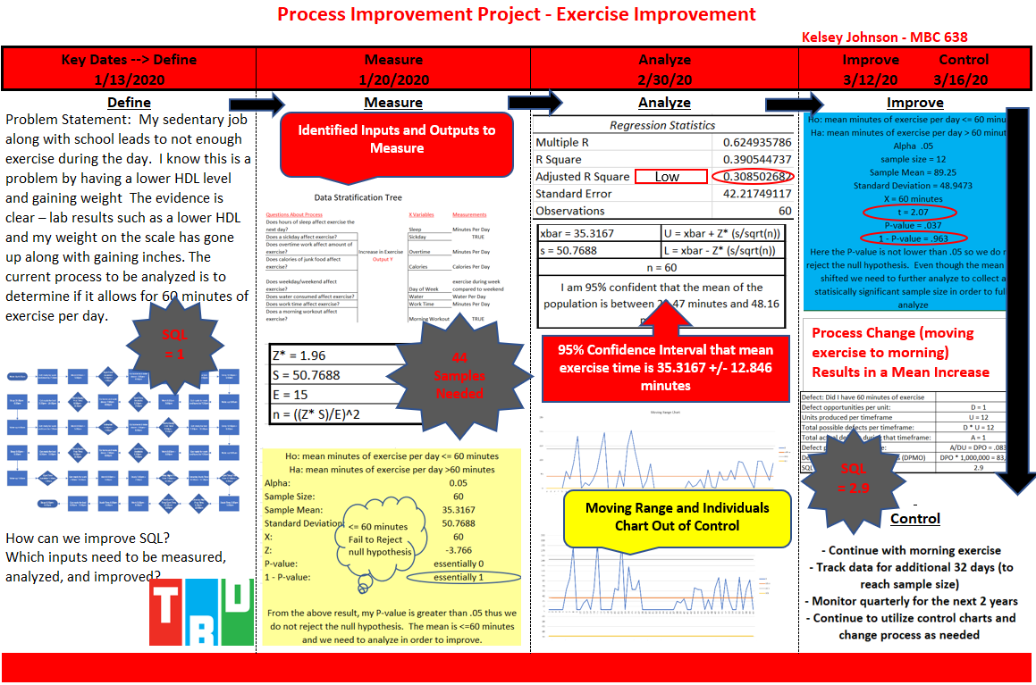

Slide 3
Executive Summary – Current Process
Problem Statement: My sedentary job along with school leads to not enough exercise during the day. I know this is a problem by having a lower HDL level and gaining weight The evidence is clear – lab results such as a lower HDL and my weight on the scale has gone up along with gaining inches when measuring my body. The current process to be analyzed is to determine if it allows for 60 minutes of exercise per day.
Process Flow: Built around my daily schedule and includes opportunities for exercise.
Identified Inputs include minutes of exercise, minutes of sleep, minutes of overtime, minutes of work, calories of junk food consumed, water consumed (ml), Sick day, and morning workout. Identified Output is Minutes of Exercise.
The calculated SQL = 1.
A calculation of samples needed concluded I need 44 samples.
For this process, my P-value calculated was greater than .05 (alpha) and we do not reject the null hypothesis that the mean minutes of exercise per day <= 60 minutes.
Confidence Interval showed we are 95% confident that the mean of the population is between 22.47 minutes and 48.16 minutes.
The multiple regression showed a low Multiple R (0.624935786) and a low Adjusted R Squared (0.308502682).
The Moving Range and Individuals Charts showed my Output is out of control. It exceeded Upper limits on both charts' multiple times.
My two highest correlations were: water consumed and Minutes of Sleep which were highest with .5928, and calories of junk food consumed and minutes of work which were the second highest with .5594.

Slide 4
Problem Statement and Key Details
Problem Statement: My sedentary job along with school leads to not enough exercise during the day. I know this is a problem by having a lower HDL level and gaining weight The evidence is clear – lab results such as a lower HDL and my weight on the scale has gone up along with gaining inches when measuring my body. The current process to be analyzed is to determine if it allows for 60 minutes of exercise per day.
Success: I will consider this process as an acceptable process if my mean minutes of exercise per day are above 60 and my process remains in control.
I have selected 10 tools to follow the DMAIC process.
My data is continuous for my output of Minutes of Exercise.
My data is continuous for my inputs of Minutes of Sleep, Minutes of Overtime, Minutes of Work, Calories of Junk Food Consumed, Water consumed (ml).
My data is discrete for Sick Day and Morning Workout.
Baseline or X = 60 minutes

Slide 5
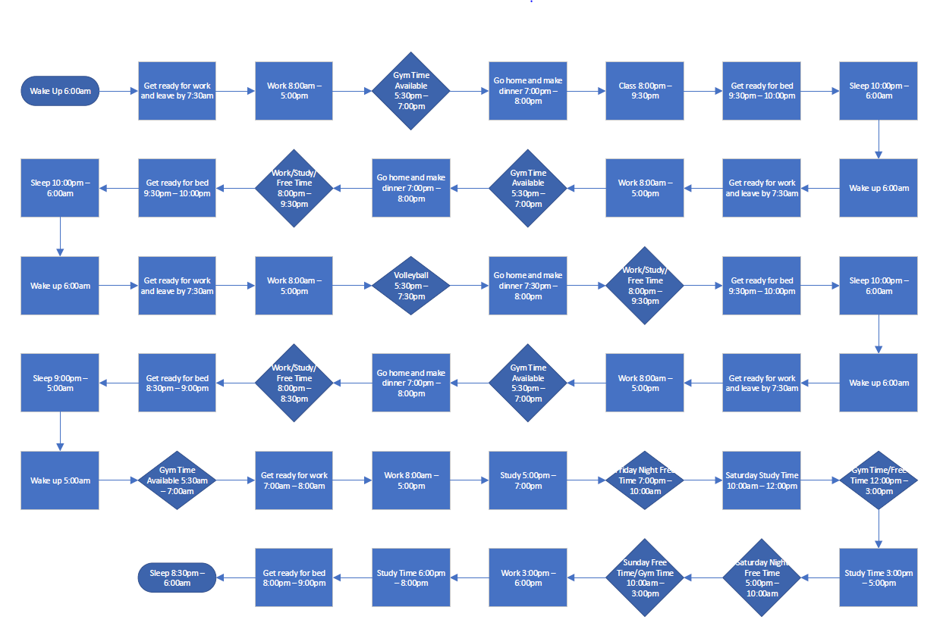
Tool 1: Process Flow
My process flow was designed around my daily schedule for each day of the week.
It highlights gym time along with volleyball as opportunities for exercise.
Current process allows for minimum 60 minutes of exercise per day.

Slide 6
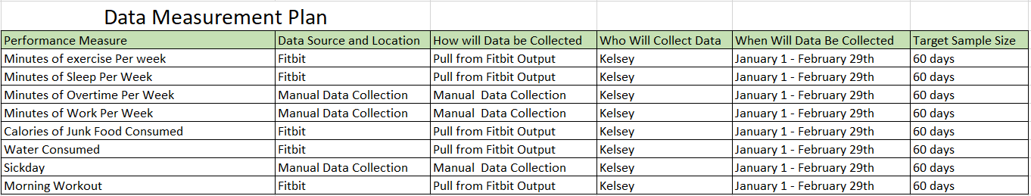
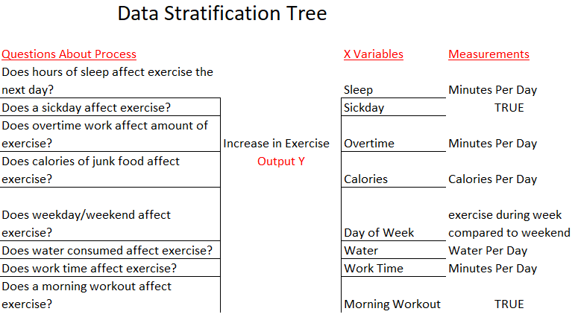
Tool 2: Data Stratification Tree and Data Measurement Plan
My Data Measurement Plan shows the performance measures I chose along with the data source and when it will be collected.
I manually collected data and pulled data from my Fitbit.
My Data Stratification Tree shows the questions I used to determine my inputs along with those measurements.
For my discrete data I used a True value (1 in my data instead of 0).

Slide 7
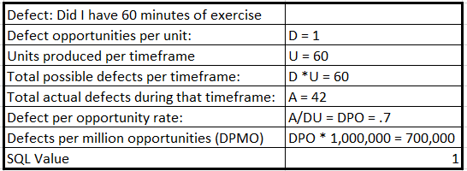
Tool 3: Sigma Quality Level (SQL)
My defect was identified – Did I have 60 minutes of exercise?
I had one opportunity per day.
60 days of data.
Actual defects calculated were 42 (42 days without 60 minutes of exercise).
Based on the complete calculation to the right, my SQL = 1.
1 is a low SQL and should review for opportunities to increase.

Slide 8
Tool 4: Normal Distribution and Hypothesis Testing
Normal Distribution
Hypothesis Testing
What is the proportion of exercise output below 60 minutes?
Calculated Mean =AVERAGE(B2:B61) = 35.3167
Standard Deviation =STDEV(B2:B61) = 50.7688
Sample Size = 60
X = 60
Alpha = .05
z = 60 - 35.3167/50.7688 = 0.486190337
=NORM.DIST(1,35.3167,50.7688,TRUE) = 0.686583889 = P-value
From the Z table, the proportion of exercise output below 60 minutes is 68.44%
Ho: mean minutes of exercise per day <= 60 minutes
Ha: mean minutes of exercise per day > 60 minutes
Z = (35.3167 – 60)/(50.7688/(sqrt(60))
Z = -24.6833/6.5542 = -3.766
P-value = essentially 0
1 – P-value = essentially 1
P-value is greater than .05 thus we do not reject the null hypothesis.
The mean is <= 60 minutes and we need to analyze in order to improve.

Slide 9
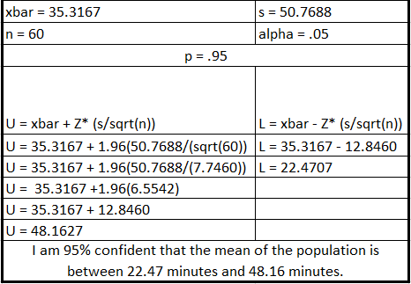
Tool 5: Confidence Interval
Calculation above shows the confidence interval = 35.3167 (mean minutes of exercise)
+/- 12.8460 minutes.
Thus my current process needs to be improved upon to increase my mean to 60 minutes.

Slide 10
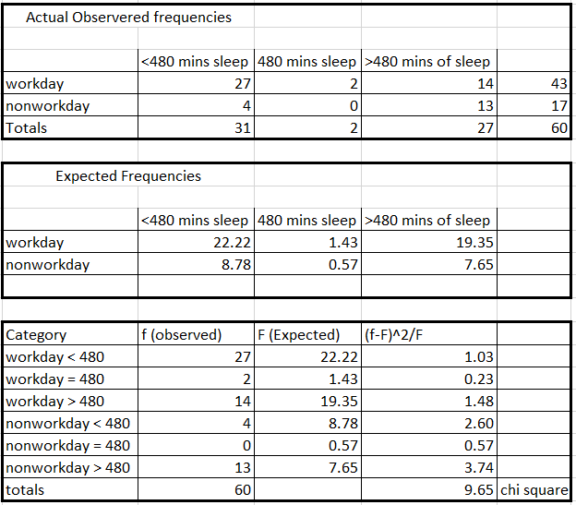
Tool 6: Chi Square
Ho: type of day and hours of sleep are independent (no relationship).
Ha: type of day and hours of sleep are not independent (is a relationship).
Degrees of Freedom = df = (r-1) * (c-1) = (2-1) * (3-1) = 2.
Alpha = .05.
P-value = =CHISQ.DIST.RT(9.65,2) = 0.008026554.
P-value = =CHISQ.TEST(C8:E9,C15:E16) = .008041678
P-value is less than .05 so we do reject the null hypothesis. There is evidence that sleep, and type of day are not independent. There is A relationship.

Slide 11
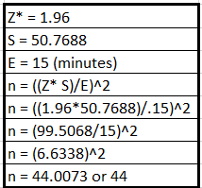
Tool 7: Sample Size
44 samples are needed to detect a change in the population mean.
There was a sufficient amount of data collected to analyze the current process (n = 60).
My measurement error was 15 minutes; however I could narrow this down to 5 minutes and recalculate to make my sample more precise.

Slide 12
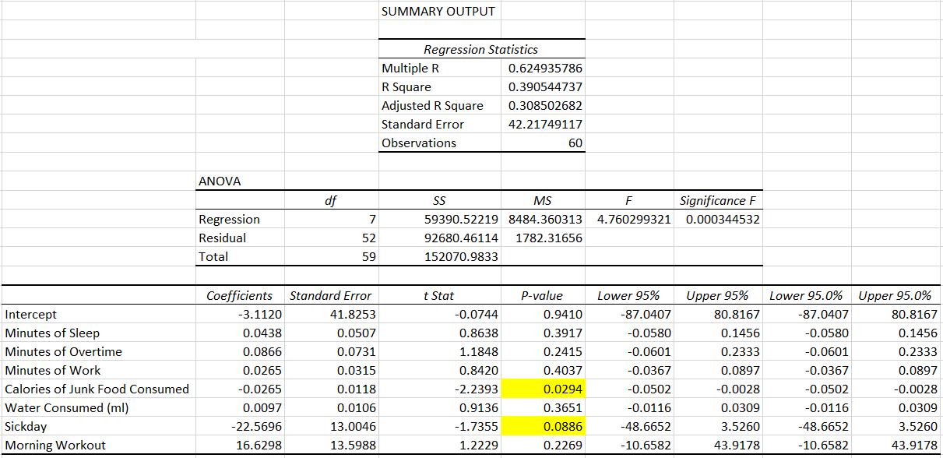
Tool 8: Multiple Regression
yhat = -3.1120 + .0438sleep + .0866overtime + .0265work - .0265calories + .0097water - 22.5696sickday + 16.6298morning.
Calories of Junk Food Consumed and Sickday are the only inputs that are statistically significant (Greater than Alpha = .05). Both have a negative relationship with exercise. Only 30.85% of the output can be explained by the model using these inputs. This is not a strong relationship, but it is closer to 1 (stronger side) than 0.
To increase model efficiency (not efficient as is) I would run using the statistically significant inputs. This would decrease my Significance F, Adjusted R Square, and Multiple R. See Appendix for output of this regression.

Slide 13
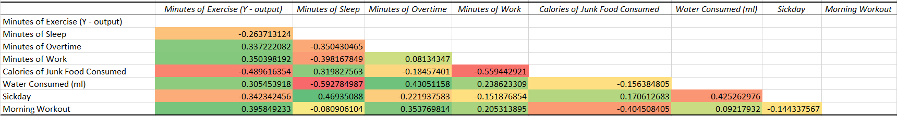
Tool 9: Correlation
For my correlation chart I showed the highest negative correlation in red and the highest positive correlation in green.
We use the absolute value to determine the highest correlation.
The two inputs with the highest correlations are:
water consumed and minutes of sleep have highest correlation of .5928.
calories and minutes of work have the second highest correlation of .5594.

Slide 14
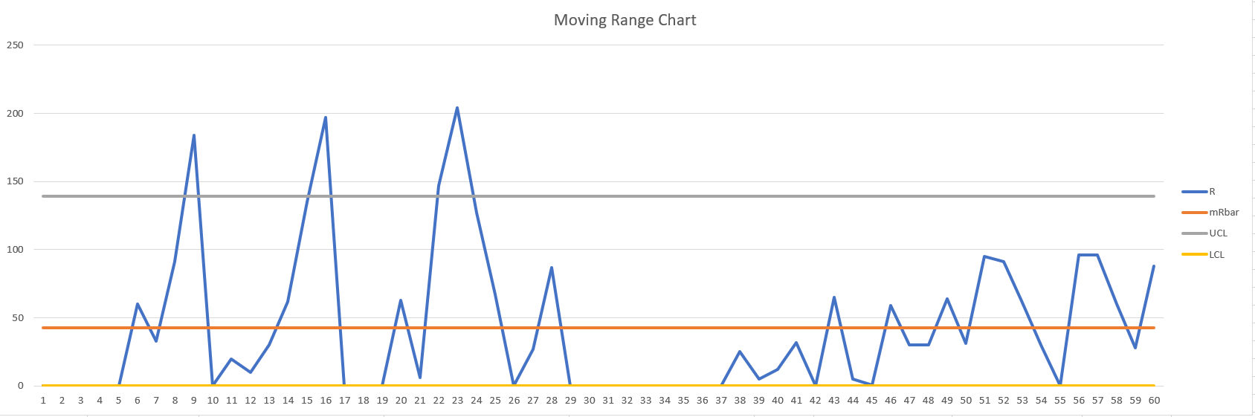
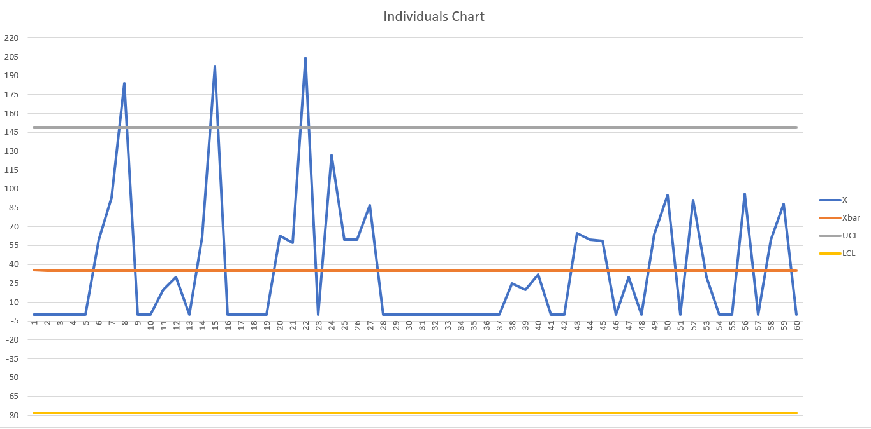
Tool 10: Control Charts
Moving Range Chart
mRbar =AVERAGE(E4:E63) = 42.57
UCL = D4 *mRbar = =3.27*42.57 = 139.19
LCL = D3*mRbar = 0*42.57 = 0
Individuals Chart
xBar = =AVERAGE(I4:I63)
UCL = UCL = xbar + E2 *mRbar = 148.55.
LCL = LCL = xbar - E2*mRbar = -77.91.
Both MR and Individuals Charts were out of control.
Process change is needed to keep in control.

Slide 15
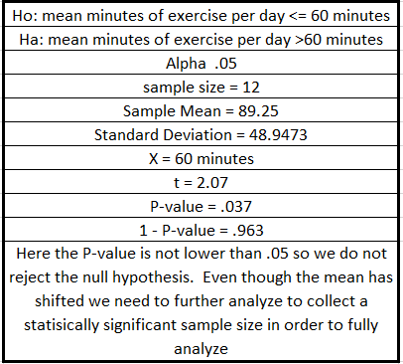
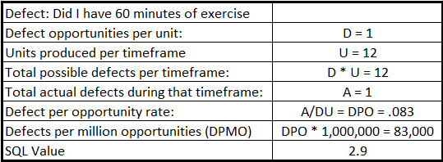
Process Change
After the Define, Measure, and Analyze phases I have determined a process change is needed.
Current process did not allow for 60 minutes of exercise per day and the process was out of control
with a low SQL.
Process has been updated to move exercise time to the morning each day.
Sample of 12 days of data (not statistically significant) have been collected to begin analysis on the
process change.
SQL has increased! Mean has increased!
P-value is not lower than alpha = .05. Do not reject the null hypothesis.
Sigma Quality Level = 2.9
Hypothesis Test:
Track data for additional 32 days to reach needed sample size and re-analyze data.
Monitor quarterly for the next 2 years and make process changes as needed.
Utilize control charts to make sure process stays in control.

Slide 16
Following DMAIC allows for a process to be fully analyzed.
The Define Phase allows you to take a full look at your process and identify your problem. For this project, I used a process map to layout my daily process and where I exercise in that process.
The Measurement Phase allows you to identify your critical Inputs and Output along with a baseline. You can identify the sample size needed for your analysis. Once you have fully tracked the data you need to measure you can create your hypothesis statements and get your P-value. For this project, my sample size was 44 and we did not reject the null hypothesis.
The Analyze Phase allows you to utilize tools to determine root cause and if your inputs statistically affect your output. For this project, my regression analysis showed that I had only 2 inputs that were statistically significant, along with a low Adjusted R Square for 7 Inputs. My confidence interval showed that my mean was 35.3167 +/- 12.846 minutes of exercise (clearly shows I’m not above my 60 minutes of exercise the process is supposed to have). My Moving Range and Individuals Charts were both out of control. A process change is needed to keep these in control and increase my mean. I can then run my multiple regression again and decide if I should identify other inputs to help improve my model.
The Improve Phase allows you to determine and make your process change, re-measure your data and analyze the new data. For this project, I only had a sample size of 12 after the process change to analyze (not statistically significant), but it showed that my mean has increased to above 60 minutes of exercise, we reject the null hypothesis, and my SQL has increased.
The Control Phase allows for monitoring going forward and allowing for the time to make process changes as the process becomes out of control. You should continue to monitor for 2 years at least quarterly to ensure the process continues to work as expected. For this project, I would continue to collect data for 32 more days in order to reach my sample size – and then analyze the data. If process is acceptable then I can continue to monitor and make changes as needed.
C
O
N
C
L
U
S
I
O
n

Slide 17
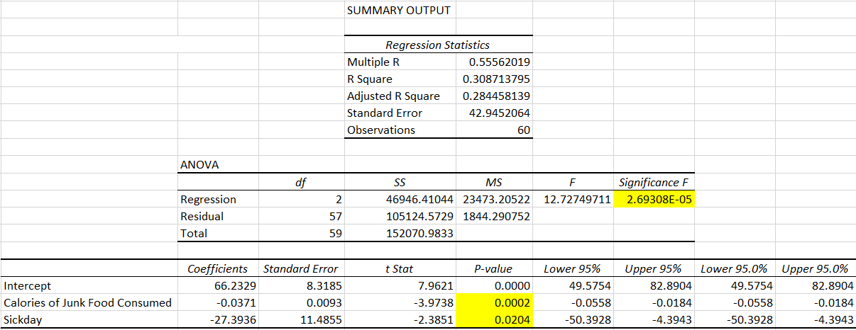
Appendix: Multiple Regression
yhat = 66.2329 – 0.0371calories – 27.3936sickday.
Both have a negative relationship with exercise. 28.45% of model is explained by inputs. Need to find other statistically significant inputs – further research.
Multiple R, Adjusted R Square, and Significance F have decreased. The lower F shows this model is more predictive with only 2 inputs, vs the prior model with 7 inputs.

